Slide 1
Face to face with death Revelation 2:8-11
And to the angel of the church in Smyrna write: 'These are the words of he who is the First and the Last, who died and came to life again. I know your afflictions (tribulations) and your poverty (yet you are rich)! I know the slander of those who say they are Jews and are not, but are a synagogue of Satan.

Slide 2
Face to face with death Revelation 2:8-11
Do not be afraid of what you are about to suffer. I tell you, the devil will put some of you in prison, to test you, you will suffer persecution (tribulation) for ten days. Be faithful, even unto the point of death, and I will give you the crown of life. He who has an ear, let him hear what the Spirit says to the churches. He who overcomes will not be hurt at all by the second death.'

Slide 3
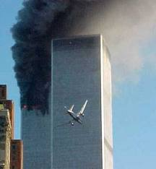
Face to face with death Revelation 2:8-11

Slide 4
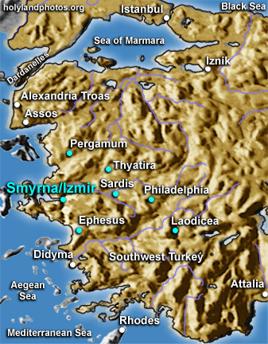
Face to face with death Revelation 2:8-11

Slide 5
Face to face with death Revelation 2:8-11

Slide 6
Face to face with death Revelation 2:8-11

Slide 7
Face to face with death Revelation 2:8-11

Slide 8
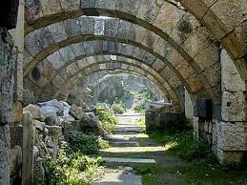
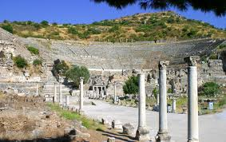
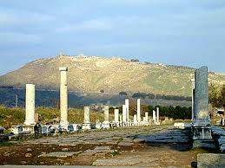
Face to face with death Revelation 2:8-11
Smyrna : the context

Slide 9
Revelation 2:8-11
The identity of the speaker
”To the angel of the church in Smyrna write: ‘These are the words of him who is the First and the Last, who died and came to life again.’” (see 1:17-18)

Slide 10
Revelation 2:8-11
The identity of the speaker
the First and the Last

Slide 11
Revelation 2:8-11
The identity of the speaker
The First and the Last
This is what the LORD says, Israel’s King and Redeemer, the LORD Almighty: “I am the first and the last; apart from me there is no God. Listen to me, O Jacob, Israel, whom I have called: I am he; I am the first and the last.”
(Isaiah 44:6; 48:12)

Slide 12
Revelation 2:8-11
The identity of the speaker
The First and the Last
The Alpha et the Omega
“I am the Alpha and the Omega” says the Lord God, “who is, and who was, and who is to come, the Almighty. I am the Alpha and the Omega, the First and the Last, the Beginning and the End.”
1:8; 22:13

Slide 13
Revelation 2:8-11
The identity of the speaker
The First and the Last
The Alpha et the Omega
The one who died and came to life again
“Do not be afraid. I am the First and the Last. I am the Living One; I was dead, and behold I am alive for ever and ever! And I hold the keys of death and Hades.”
1:17b-18

Slide 14
Revelation 2:8-11
The identity of the speaker
The prophetic message – “I know”

Slide 15
Revelation 2:8-11
1. The identity of the speaker
2. The prophetic message – “I know”
Your afflictions/tribulations…”

Slide 16
Revelation 2:8-11
1. The identity of the speaker
2. The prophetic message – “I know”
Your afflictions/tribulations…”

Slide 17
Revelation 2:8-11
1. The identity of the speaker
2. The prophetic message – “I know”
Your afflictions/tribulations…”
“In this world you will have trouble. But take heart! I have overcome the world.” (John 16:33)

Slide 18
Revelation 2:8-11
1. The identity of the speaker
2. The prophetic message – “I know”
…your afflictions/tribulations…”
Why does God allow suffering?
My son, do not make light of the Lord’s discipline, and do not lose heart when he rebukes you, because the Lord disciplines those whom he loves, and punishes everyone he accepts as a son. Endure hardship as discipline; God is treating you as sons. For what son is not disciplined by his father? No discipline seems pleasant at the time, but painful. Later on, however, it produces a harvest of righteousness and peace for those who have been trained by it. (Hebrews 12:5-7,11)
Praise be to the God and Father of our Lord Jesus Christ, the Father of compassion and the God of all comfort, who comforts us in all our troubles, so that we can comfort those in any trouble with the comfort we ourselves have received from God. (2 Cor 1:3-4)

Slide 19
Revelation 2:8-11
1. The description of the speaker
2. The prophetic message “I know…
Your affliction/tribulation…
Your poverty.”

Slide 20
Revelation 2:8-11
1. The description of the speaker
2. The prophetic message “I know…
your affliction/tribulation
your poverty– yet you are rich!
“Do not store up for yourselves treasures on earth…but store up for yourselves treasures in heaven, where moth and rust do not destroy and where thieves do not break in and steal. For where your treasure is, there will your heart be also.” (Mt 6:19-21)
It is better to be “rich towards God.”
(Luke 12:21).

Slide 21
Revelation 2:8-11
1. The description of the speaker
2. The prophetic message - “I know…
Your affliction/tribulation
Your poverty– yet you are rich
pseudo-Jews”

Slide 22
Revelation 2:8-11
1. The description of the speaker
2. The prophetic message - “I know…
Your affliction/tribulation
Your poverty– yet you are rich
“pseudo-Jews”
The promises were spoken to Abraham and to his seed. The Scripture does not say “and to seeds”, meaning many people, but “and to your seed”, meaning one person who is Christ…If you belong to Christ, then you are Abraham’s seed, and heirs according to the promise. (Gal 3:16,29)

Slide 23
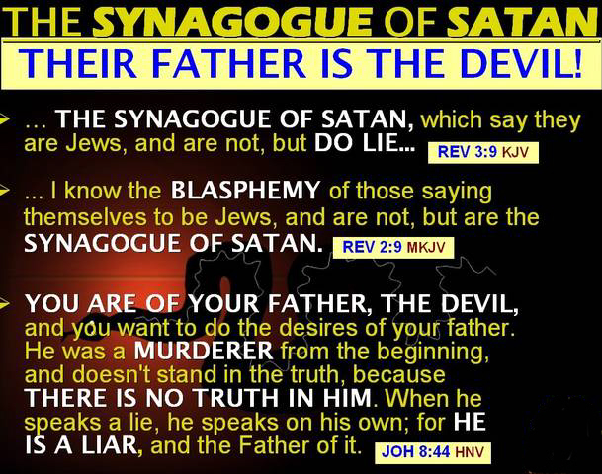
Revelation 2:8-11
1. The description of the speaker
2. The prophetic message - “I know…
Your affliction/tribulation
Your poverty– yet you are rich
“pseudo-Jews”
Synagogue of Satan

Slide 24
Revelation 2:8-11
1. The description of the speaker
2. The prophetic message - “I know…”
3. The exhortation
“Do not be afraid…”

Slide 25
Revelation 2:8-11
1. The description of the speaker
2. The prophetic message - “I know…”
3. The exhortation
“Do not be afraid…”
prison for some

Slide 26
Revelation 2:8-11
1. The description of the speaker
2. The prophetic message “I know…”
3. The exhortation
“Do not be afraid…”
prison for some
Persecution for ten days

Slide 27
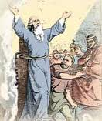
Revelation 2:8-11
1. The description of the speaker
2. The prophetic message “I know…”
3. The exhortation
“Do not be afraid…”
prison for some
Persecution for ten days
Remain faithful…

Slide 28
Revelation 2:8-11
1. The description of the speaker
2. The prophetic message “I know…”
3. The exhortation
4. Final exhortation and promise
“Be faithful even to the point of death, and I will give you the crown of life”

Slide 29
Revelation 2:8-11
1. The description of the speaker
2. The prophetic message “I know…”
3. The exhortation
4. Final exhortation and promise
“Be faithful even to the point of death, and I will give you the crown of life”
“crown” = laurels given to
the winner

Slide 30
Revelation 2:8-11
1. The description of the speaker
2. The prophetic message “I know…”
3. The exhortation
4. Final exhortation and promise
“Be faithful even to the point of death, and I will give you the crown of life”
“the crown of life that God has promised to those that love him” James 1:12
“the crown of glory that will never fade away.” 1 Peter 5:4

Slide 31
Revelation 2:8-11
1. The description of the speaker
2. The prophetic message “I know…”
3. The exhortation
4. Final exhortation and promise
“Be faithful even to the point of death, and I will give you the crown of life”
“He who overcomes will not be hurt at all by the second death!”
Death and Hades were thrown into the lake of fire. The lake of fire is the second death. If anyone’s name is not found written in the book of life, he was thrown into the lake of fire.
Revelation 20:14,15

Slide 32
Revelation 2:8-11
1. The description of the speaker
2. The prophetic message “I know…”
3. The exhortation
4. Final exhortation and promise
“Be faithful even to the point of death, and I will give you the crown of life”
“He who overcomes will not be hurt at all by the second death!”
“The rest of the dead did not come to life until the thousand years were ended. This is the first resurrection.” Rev.20:5
“Today you shall be with me in Paradise”

Slide 33
Revelation 2:8-11
1. The description of the speaker
2. The prophetic message “I know…”
3. The exhortation
4. Final exhortation and promise
5. The Christian and death

Slide 34
Revelation 2:8-11
1. The description of the speaker
2. The prophetic message “I know…”
3. The exhortation
4. Final exhortation and promise
5. The Christian and death
“a small thing is still a small thing, but being faithful in small things is, at the same time, a small thing and a big thing.” Hudson Taylor

Slide 35
Revelation 2:8-11
Final lessons:

Slide 36
Revelation 2:8-11
Final lessons:
God knows all about us

Slide 37
Revelation 2:8-11
Final lessons:
God knows all about us
He encourages us to remain faithful

Slide 38
Revelation 2:8-11
Final lessons:
God knows all about us
He encourages us to remain faithful
He promises the crown of life

